Slide 1
Time and clocks
10.1 Introduction
10.2 Clocks, events and process states
10.3 Synchronizing physical clocks
10.4 Logical time and logical clocks

Slide 2
10.1 Introduction
We need to measure time accurately:
  to know the time an event occurred at a computer
  to do this we need to synchronize its clock with an authoritative external clock
Algorithms for clock synchronization useful for
  concurrency control based on timestamp ordering
  authenticity of requests e.g. in Kerberos
There is no global clock in a distributed system
  this chapter discusses clock accuracy and synchronisation
Logical time is an alternative
  It gives ordering of events - also useful for consistency of replicated data
•
Notes:
NFS client caching no need for synchronisation between client and server clocks
For validation, check whether client clock has increased by 3 seconds, then compare two timestamps from the same server
Need clocks to increase monotonically and at a reasonably accurate rate (if very fast checks will occur too often, if slow, not often enough)

Slide 3
Computer clocks and timing events
Each computer in a DS has its own internal clock
  used by local processes to obtain the value of the current time
  processes on different computers can timestamp their events
  but clocks on different computers may give different times
  computer clocks drift from perfect time and their drift rates differ from one another.
  clock drift rate: the relative amount that a computer clock differs from a perfect clock
Even if clocks on all computers in a DS are set to the same time, their clocks will eventually vary quite significantly unless corrections are applied
•
Notes:
Make requires monotonic clock values (increases in time)
When make uses files served by NFS, the client and server clocks need to be synchronised.
In general any program that uses local and server files and compres their timestamps would require loose synchronosation between client and server.

Slide 4
10.2 Clocks, events and process states
A distributed system is defined as a collection P of N processes p_{i}, i = 1,2,… N
Each process p_{i} has a state s_{i} consisting of its variables (which it transforms as it executes)
Processes communicate only by messages (via a network)
Actions of processes:
  Send, Receive, change own state
•

Slide 5
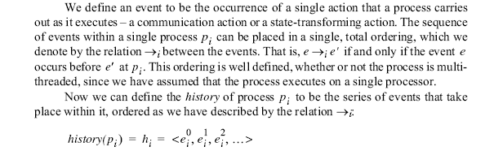

Slide 6
Clocks
We have seen how to order events (happened before)
To timestamp events, use the computer’s clock
At real time, t, the OS reads the time on the computer’s hardware clock H_{i}(t)
It calculates the time on its software clock
C_{i}(t)= αH_{i}(t) + β
•
Notes:
Clock resolution - the period between updates of the value of the clock

Slide 7
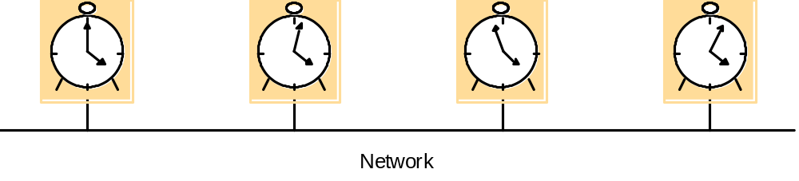
Skew between computer clocks in a distributed system
Figure 10.1
Computer clocks are not generally in perfect agreement
Skew: the difference between the times on two clocks (at any instant)
Computer clocks are subject to clock drift (they count time at different rates)
Clock drift rate: the difference per unit of time from some ideal reference clock
Ordinary quartz clocks drift by about 1 sec in 11-12 days. (10⁻⁶ secs/sec).
High precision quartz clocks drift rate is about 10⁻⁷ or 10⁻⁸ secs/sec
•
Notes:
Low batteries -> large drift rate

Slide 8
Coordinated Universal Time (UTC)
International Atomic Time is based on very accurate physical clocks (drift rate 10⁻¹³)
UTC is an international standard for time keeping
It is based on atomic time, but occasionally adjusted to astronomical time
It is broadcast from radio stations on land and satellite (e.g. GPS)
Computers with receivers can synchronize their clocks with these timing signals
Signals from land-based stations are accurate to about 0.1-10 millisecond
Signals from GPS are accurate to about 1 microsecond
•
Notes:
GPS does not work inside buildings

Slide 9
10.3 Synchronizing physical clocks
External synchronization
  A computer’s clock C_{i} is synchronized with an external authoritative time source S, so that:
  |S(t) - C_{i}(t)| < D for i = 1, 2, … N over an interval, I of real time
  The clocks C_{i} are accurate to within the bound D.
Internal synchronization
  The clocks of a pair of computers are synchronized with one another so that:
  | C_{i}(t) - C_{j}(t)| < D for i = 1, 2, … N over an interval, I of real time
  The clocks C_{i} and C_{j} agree within the bound D.
Internally synchronized clocks are not necessarily externally synchronized, as they may drift collectively
if the set of processes P is synchronized externally within a bound D, it is also internally synchronized within bound 2D
•

Slide 10
Clock correctness
A hardware clock, H is said to be correct if its drift rate is within a bound ρ > 0. (e.g. 10⁻⁶ secs/ sec)
This means that the error in measuring the interval between real times t and t’ is bounded:
  (1 - ρ ) (t’ - t) ≤ H(t’) - H(t) ≤ (1 + ρ ) (t’ - t) (where t’>t)
  Which forbids jumps in time readings of hardware clocks
Weaker condition of monotonicity
  t' > t ⇒ C(t’) > C(t)
  e.g. required by Unix make
  can achieve monotonicity with a hardware clock that runs fast by adjusting the values of α  β  C_{i}(t)= αH_{i}(t) + β
a faulty clock is one that does not obey its correctness condition
crash failure - a clock stops ticking
arbitrary failure - any other failure e.g. jumps in time
•
Notes:
I hope they will answer the Y2k problem is an arbitrary failure (it makes 1 Jan 2000 be 1 Jan 1900)

Slide 11
10.3.1 Synchronization in a synchronous system
Internal synchronization in a synchronous system
  One process p₁ sends its local time t to process p₂
  in a message m,
  p₂ could set its clock to t + T_{trans} where T_{trans} is the
  time to transmit m
  T_{trans} is unknown but min ≤ T_{trans} ≤ max
  uncertainty u = max-min. Set clock to t + (max - min)/2
  then skew ≤ u/2
•
Notes:
For internal synchronization discuss min is the time to transmit a message when nothing else is going on.
max is the upper bound .The internet is an asynchronous system because there is no upper bound on message transmission delays.

Slide 12
Cristian’s method (1989) for an asynchronous system
A time server S receives signals from a UTC source
  Process p requests time in m_{r} and receives t in m_{t} from S
  p sets its clock to t + T_{round}/2
  Accuracy ± (T_{round}/2 - min) :
    because the earliest time S puts t in message m_{t} is min after p sent m_{r}.
    the latest time was min before m_{t} arrived at p
    the time by S’s clock when m_{t} arrives is in the range [t+min, t + T_{round} - min]
T_{round} is the round trip time recorded by p
min is an estimated minimum round trip time
m
r
m
t
p
Figure 10.2
Time server,S
•
Notes:
The algorithm is probabilistic. Works if round trip times are shortB

Slide 13
Berkeley algorithm
Cristian’s algorithm -
  a single time server might fail, so they suggest the use of a group of synchronized servers
  it does not deal with faulty servers
Berkeley algorithm (also 1989)
  An algorithm for internal synchronization of a group of computers
  A master polls to collect clock values from the others (slaves)
  The master uses round trip times to estimate the slaves’ clock values
  It takes an average (eliminating any above some average round trip time or with faulty clocks)
  It sends the required adjustment to the slaves (better than sending the time which depends on the round trip time)
  Measurements
    15 computers, clock synchronization 20-25 millisecs drift rate < 2x10⁻⁵
    If master fails, can elect a new master to take over (not in bounded time)
•

Slide 14
Network Time Protocol (NTP)
A time service for the Internet - synchronizes clients to UTC
Reliability from redundant paths, scalable, authenticates time sources
Primary servers are connected to UTC sources
Secondary servers are synchronized to primary servers
Synchronization subnet - lowest level servers in users’ computers
1
2
2
3
3
3
Figure 10.3
•
Notes:
animates the points relaibility, primary and secondary servers

Slide 15
NTP - synchronisation of servers
The synchronization subnet can reconfigure if failures occur, e.g.
  a primary that loses its UTC source can become a secondary
  a secondary that loses its primary can use another primary
Modes of synchronization:
Multicast
    A server within a high speed LAN multicasts time to others which set clocks assuming some delay (not very accurate)
Procedure call
    A server accepts requests from other computers (like Cristiain’s algorithm). Higher accuracy. Useful if no hardware multicast.
Symmetric
    Pairs of servers exchange messages containing time information
    Used where very high accuracies are needed (e.g. for higher levels)
•

Slide 16
Messages exchanged between a pair of NTP peers
All modes use UDP
Each message bears timestamps of recent events:
  Local times of Send and Receive of previous message
  Local times of Send of current message
Recipient notes the time of receipt T_{i} ( we have T_{i-3}, T_{i-2}, T_{i-1}, T_{i})
In symmetric mode there can be a non-negligible delay between messages
Server B
T
i
-2
T
i-1
Time
Figure 10.4
m
m'
Time
Server A
T
i
-
3
T
i
•
Notes:
Local times of Send and Receive of previous message
Local times of Send of current message
Recipient notes the time of receipt ( we have T_{i-3}, T_{i-2}, T_{i-1}, T_{i})
In symmetric mode there can be a non-negligible delay between messages

Slide 17
Accuracy of NTP
For each pair of messages between two servers, NTP estimates an offset o, between the two clocks and a delay d_{i} (total time for the two messages, which take t and t’)
  T_{i-2} = T_{i-3} + t + o and T_{i} = T_{i-1} + t’ - o
This gives us (by adding the equations) :
  d_{i} = t + t’ = T_{i-2} - T_{i-3} + T_{i} - T_{i-1}
Also (by subtracting the equations)
  o = o_{i} + (t’ - t )/2 where o_{i} = (T_{i-2} - T_{i-3} + T_{i-1} - T_{i})/2
Using the fact that t, t’>0 it can be shown that
  o_{i} - d_{i} /2 ≤ o ≤ o_{i} + d_{i} /2 .
  Thus o_{i} is an estimate of the offset and d_{i} is a measure of the accuracy
NTP servers filter pairs <o_{i}, d_{i}>, estimating reliability from variation, allowing them to select peers
Accuracy of 10s of millisecs over Internet paths (1 on LANs)
•
Notes:
from the above: o-oi = (t’-t)/2
therefore |o-oi| = |t’-t|/2
now |t’-t| <= |t’+t| = di therefore |o-oi| <=di/2. i.e. o-oi<=dii/2 or o<oi+di/2
also -o+oi<= di/2 i.e. oi-di/2 <= o

Slide 18
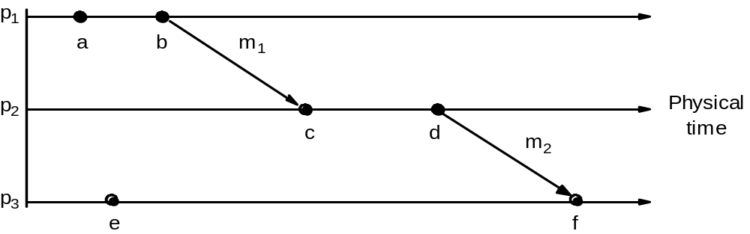
Logical time and logical clocks (Lamport 1978)
Instead of synchronizing clocks, event ordering can be used
a → b (at p1) c →d (at p2)
b → c because of m1
also d → f because of m2
  If two events occurred at the same process p_{i} (i = 1, 2, … N) then they occurred in the order observed by p_{i}
  when a message, m is sent between two processes, send(m) happened before receive(m)
  The happened before relation is transitive
the happened before relation is the relation of causal ordering
Figure10.5
•
Notes:
Animation explains the following:
In Figure 10.5 a -> b (at p1) c->d at p2 and b->c because of m1 also d-> f because of m2.
Not all events are related by -> (happened before) consider a and e. (different processes and no chain of messages to relate them)
Happened before relation - relation of causal ordering
HB1, HB2 and HB3 (page 397) are formal statements of the three points on the slide

Slide 19
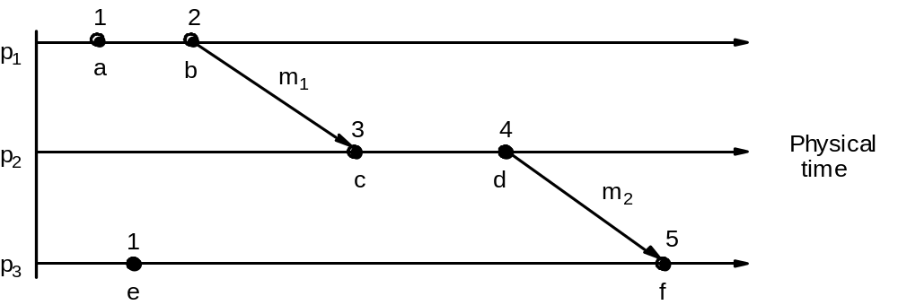
Lamport’s logical clocks
A logical clock is a monotonically increasing software counter. It need not relate to a physical clock.
Each process p_{i} has a logical clock, L_{i} which can be used to apply logical timestamps to events
  LC1: L_{i} is incremented by 1 before each event at process p_{i}
  LC2:
  (a) when process p_{i} sends message m, it piggybacks t = L_{i}
  (b) when pj receives (m,t) it sets L_{j} := max(L_{j}, t) and applies LC1 before timestamping the event receive (m)
each of p1, p2, p3 has its logical clock initialised to zero,
the clock values are those immediately after the event.
e.g. 1 for a, 2 for b.
for m1, 2 is piggybacked and c gets max(0,2)+1 = 3
Figure 10.6
•
Notes:
Discuss LC1 and LC2 for Figure 10.6 (same as 10.5).
Initially clocks all set to 0. (a -> 1) b->2 etc. For m1, 2 is piggybacked and c gets max(1,2) + 1. Same for m2.
Note e -> e’ implies L(e) < L(e’). Converse not true. E.g. events b and e.
(b || e) concurrent.

Slide 20
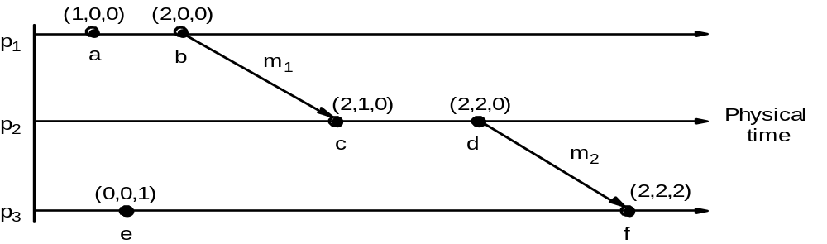
Vector clocks
Vector clock V_{i} at process p_{i} is an array of N integers
VC1:initially V_{i}[j] = 0 for i, j = 1, 2, …N
VC2:before p_{i} timestamps an event it sets V_{i}[i] := V_{i}[i] +1
VC3:p_{i} piggybacks t = V_{i} on every message it sends
VC4:when p_{i} receives (m,t) it sets V_{i}[j] := max(V_{i}[j] , t[j]) j = 1, 2, …N ( then before next event adds I to own element using VC2)
Figure 10.7
•
Notes:
Following points animated :
Vector clocks overcome the shortcoming of Lamport logical clocks (L(e) < L(e’) does not imply e happened before e’) e.g. events e and c
Vector timestamps are used to timestamp local events.
Applied in schemes for replication of data e.g. Gossip (p 572), Coda (p585) and causal multicast
The rules VC1-VC4 are for updating vector clocks
Work through figure 10.7. At p1 a(1,0,0) b (2,0,0) send (2,0,0) on m1
At p2 on receipt of m1 get max((0,0,0), (2,0,0) = (2,0,0) add 1 -> (2,1,0).
Meaning of =, <=, max etc for vector timestamps.
Note that e-> e’ implies V(e) < V(e’). The converse is also true.
But c || e parallel) because neither V(c) <= V(e) nor V(e) <= V(c).

Slide 21
Summary on time and clocks in distributed systems
accurate timekeeping is important for distributed systems.
algorithms (e.g. Cristian’s and NTP) synchronize clocks in spite of their drift and the variability of message delays.
for ordering of an arbitrary pair of events at different computers, clock synchronization is not always practical.
the happened-before relation is a partial order on events that reflects a flow of information between them.
Lamport clocks are counters that are updated according to the happened-before relationship between events.
vector clocks are an improvement on Lamport clocks,
  we can tell whether two events are ordered by happened-before or are concurrent by comparing their vector timestamps
•

